Slide 1
CS 5780 Mini – Project Gyroscope Motor Controller
By: Robert Weischedel

Slide 2
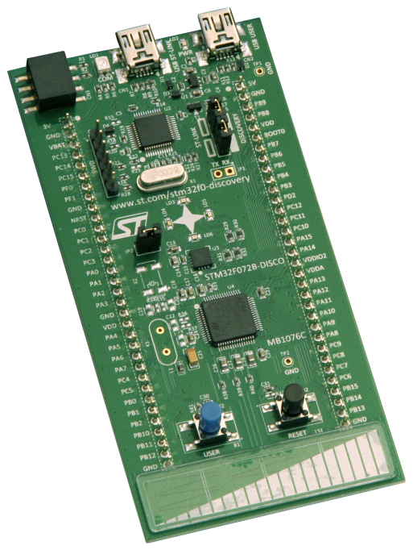
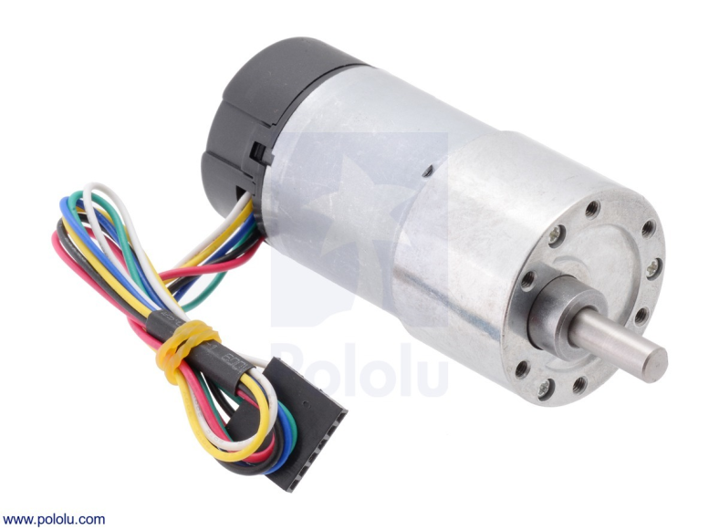
Goal
Control a motor using the gyroscope found in our STM32F0 boards.

Slide 3

Team
Just ME!

Slide 4
Materials List
32F072BDISCOVERY Board
Motor
Gyroscope (Built into Board)
Wire(s)/Cable(s)
Laptop
Kiel uVision 5
STM Studio

Slide 5
Electrical Safety Concerns
Personal Safety
Board Safety

Slide 6
Breakdown of Steps
Step 1 - Correctly interface and retrieve data with the gyroscope from the X and Y axis of the STM32F0 board.

Slide 7
Breakdown of Steps
Step 2 - Update and keep real time data from the gyroscope to feed to the motor. Need to know where exactly the position of the X axis is at all times in order to shut motor on or off and speed control.

Slide 8
Breakdown of Steps
Step 3 - Interact with the motor based on data from the gyroscope, controlling motor speed and on/off cycle.

Slide 9
Breakdown of Steps
Step 4 - Interact with motor based on data from the gyroscope, controlling the direction of the motor.

Slide 10

Current Status
Completed Step 1
Beginning Step 2!

Slide 11
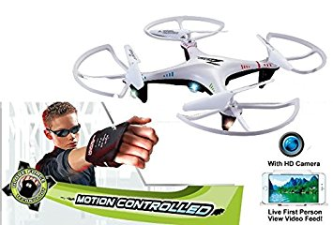
End Project Goal/Dreams

Slide 12

Questions?

